Slide 1
DATA SCIENCE

Slide 2
https://www.kaggle.com/general/210722

Slide 3
The need of Basic Terms and Definitions
Clarity and Precision: Proper definitions and consistent terminology; When everyone uses the same terms, there is less room for confusion.
Building a Strong Foundation: Solid foundation for more complex topics.
Problem-Solving Skills: Programming is fundamentally about problem-solving. Encourages to think critically and logically. It enables them to break down problems into smaller, manageable parts and express their solutions accurately.
Debugging and Troubleshooting: When encounter errors in their code (which is inevitable in programming), having a strong grasp of basic terminology can be invaluable for debugging. It allows to identify issues more effectively, which is essential for troubleshooting and problem resolution.
Reading and Understanding Documentation: Familiarity with basic terms helps students navigate documentation and understand examples and explanations provided by the R community.
Collaboration: In collaborative environments, using consistent terminology is crucial for effective communication among team members. It ensures that everyone is on the same page and can contribute effectively to a project.
Success in Advanced Topics: Finally, mastery of basic concepts and terminology is a prerequisite for success in advanced topics.
Notes:
I would like to emphasize the importance of some basic Terms and definitions. Although it sound very boring right now,
it helps you build a solid foundation for more complex tasks and enforces logical thinking

Slide 4
Data Driven Thinking
The definition of “Data” in Data-Science
Data can come in the form of text, observations, figures, images (vector, bitmap), numbers, audio, graphs, or symbols.
Data is a raw form of knowledge and you have to transform it (cleaning, analyze) and interpret it (context)

Slide 5
Data: Data is a collection of facts, signals, or symbols. Most often it comes in a form, that is raw, inconsistent, or unorganized. As such, it is not useful.
cleaning
analyzing
Information: Information is the organized and structured arrangement of data. When data is transformed into information, it becomes significantly more valuable due to the ease of storage and retrieval.
interpretation
Knowledge: Knowledge is a collection of information with its associated context. The context is in the form of relationships between information sets collected over time. Knowledge is the outcome of experience working with a pool of information.

Slide 6
Some more definitions around Data
Sources of data:
published literature sources,
surveys (email and mail),
interviews (telephone, face-to-face or focus group), observations,
documents and records (databases),
and experiments (machine acquisition of data e.g. Sequencer, Microscope)
Forms of Data:
Human readable form (Text Format: CSV, TXT, JSON, XML)
Machine readable form (Binary Format: XLSX, FCS, Images, digital audio)
Notes:
Data can be further defined by different formats and structures

Slide 7
Timeline of Programming Languages
Ranking 2023 Top 20 (Tobe Index)
Julia
7
8
1
6
10
3
20
13
12
18
19
17
2
16
4
5
14
15
Notes:
Over the last few decades, numerous programming languages have evolved to fulfill various purposes. What's intriguing to observe is that even so-called "old" languages continue to maintain their popularity within the top 20. Take Python, for instance, which remains relevant due to its applications in AI and deep learning.

Slide 8
Notes:
Programming languages can be categorized based on their level of implementation, which refers to how closely they are tied to the hardware and how much abstraction they provide to programmers. At a high level of implementation, languages offer greater abstraction, making them easier to use but potentially less efficient. In contrast, low-level languages provide less abstraction, giving programmers more control over hardware but requiring more detailed coding.
- **High-Level Languages:** These languages, like Python, JavaScript, Julia and R, provide a high level of abstraction, making programming more accessible and efficient in simplify coding. They are closer to human language and offer built-in functions and libraries for various tasks, simplifying development. However, they sacrifice some control over hardware, potentially resulting in less optimized code.
- **Mid-Level Languages:** Languages like C and C++ strike a balance between high and low levels of implementation. They offer a good mix of abstraction and control, making them suitable for system programming, game development, and performance-critical applications. Programmers can manage memory and hardware details when needed.
- **Low-Level Languages:** Assembly language and machine code are low-level languages that provide the closest control over hardware. They are challenging to work with and require detailed knowledge of a specific computer architecture. However, they enable precise optimization for performance-critical applications and system-level programming.
The choice of programming language depends on the specific requirements of a project. High-level languages are often preferred for rapid development and ease of use, while low-level languages are chosen for tasks demanding maximum control and efficiency. Mid-level languages offer a compromise, making them versatile for a wide range of applications.

Slide 9
Base R vs Tidyverse / Dplyr
Tidyverse
Base R
e.g.
C / C++
Interpreter
VS.
Compiler
OS (Operating System)
OS (Operating System)
HW (Hardware)
HW (Hardware)

Slide 10
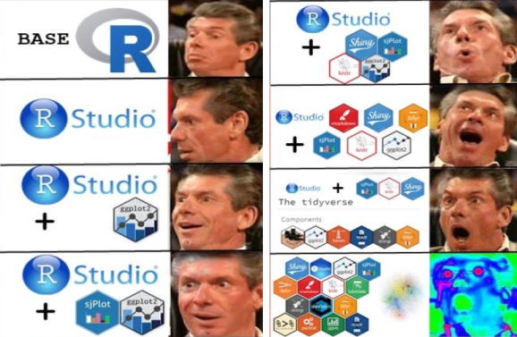
R programming
Cons and Pros

Slide 11
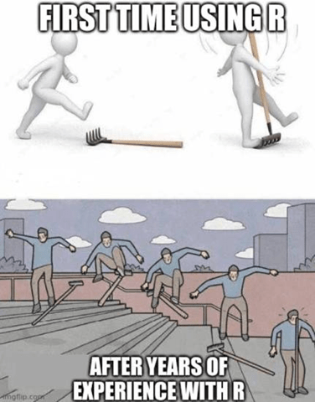
Notes:
Does R Have Any Drawbacks?
R is not an easy beginner language. R has a steep learning curve.
It’s slow. R is slower than other programming languages like Python or MATLAB.
It takes up a lot of memory. Memory management isn’t one of R’s strong points.
It doesn’t have consistent documentation/package quality. Docs and packages can be patchy and inconsistent, or incomplete.
That’s the price you pay for a language that doesn’t have official, dedicated support and instead is maintained and added to by the community.

Slide 12

Notes:
but lets talk about the good part, and why we use R:
Statistical Analysis and Data Manipulation: R was designed with a strong focus on statistical analysis and data manipulation. It provides a wide range of built-in statistical functions and libraries that allow data scientists and analysts to perform complex analyses and calculations efficiently
Rich Ecosystem of Packages: basically for every task exists a package. This many packages can be overwhelming in the beginning
Data Visualization: very powerful highly customizable and publication-quality graphs and visualizations
Open Source and Free (compare to e.g. Matlab)
Community and Learning Resources:
Academic and Research Use: R is widely used in academia and research for statistical analysis, making it a common choice for researchers
Interactive Data Exploration:

Slide 13
Get your data into R
readr: read rectangular text data, such as CSV files, TSV files, and other delimited text files.
readxl: read Excel (XLS and XLSX) files.
openxlsx: read, write, and edit Microsoft Excel (XLSX) files.
clipr: read and write data from the system clipboard, which can be useful for copying and pasting data between R and other applications.
data.table: an extension of R data.frame, designed to be more efficient and faster for handling large datasets.
haven: import and export data from SPSS, Stata, and SAS files.
foreign: import and export data from Epi Info, Minitab, S, SAS, SPSS, Stata, Systat, Weka
httr: work with URLs and HTTP requests in R.
rvest: extracts (scrape) data from web pages in R.
RCurl: offers a general network client interface, enabling various network-related operations (e.g., HTTP requests, FTP file downloads, URL handling)
feather: provide R bindings to the Feather API, which is a binary file format designed for efficient data storage and exchange.
DBI: interface for communicating with databases from R.
RMySQL: R driver for MySQL databases.
RPostgres: R driver for PostgreSQL databases.
RSQLite: R driver for SQLite databases.
sparklyr: import data into R from Spark DataFrames.
git2r: offers access to Git repositories from R.
Notes:
you have already a few ways to import your data into R, but there are many more. basically for all kind of data structure you will find a corresponding package for import

Slide 14
Data Types and Structures in
R
Single Data Type
(primitive type)
Data Structure
Composite Data Type
R has five basic or “atomic” classes of objects:
Character (Strings)
numeric (real numbers)
Integer
Complex
Logical (True/False)
Data Structures are “constructed” of simpler
Types:
Vectors
Matrices
Arrays
Lists
Data Frames
There are many other complex data types (structures)
but they are not part of the base system, like:
Tree
Graph
Hash Table

Slide 15
